Slide 1
The differences between how rich and poor countries spend their money

Slide 2
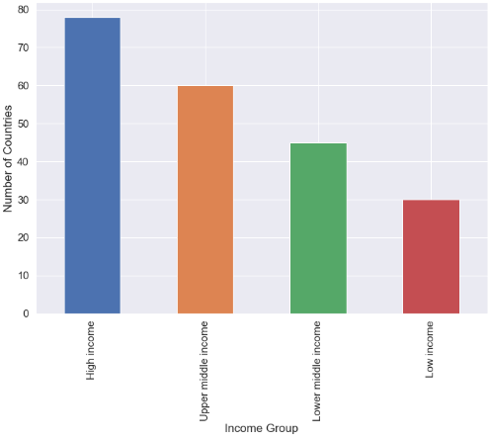
Over 1.3 billion people live in extreme poverty world wide
The economies of each country in the world are categorised from high income to low income depending on the size of GDP.
The amount that each sector contributes to the total GDP is presented as percentage of GDP (% of GDP).
This project aims to compare the differences in expenditure on different sectors of the economy between high, middle and low income countries

Slide 3
Data acquisition and cleaning
The project will utilise the World Bank Open Databank to acquire the data necessary for the analysis
We will also utilise foursquare database to find the coordinates of the countries

Slide 4
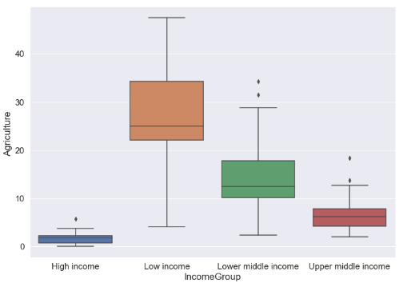
Low Income countries spend a lot more on agriculture
Agriculture makes up a much greater percentage of GDP for the poorer countries than for the richer countries
It means the countries have little amounts to invest in education, trade, and projects that will benefit them in the future
These countries are therefore trapped in the cycle of poverty and will in the long run become poorer and poorer unless interventions are done.

Slide 5
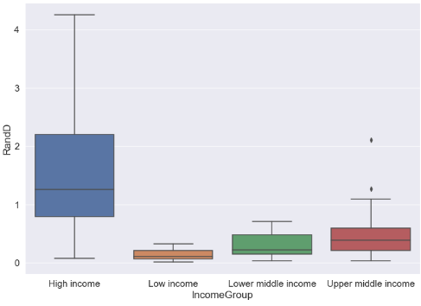
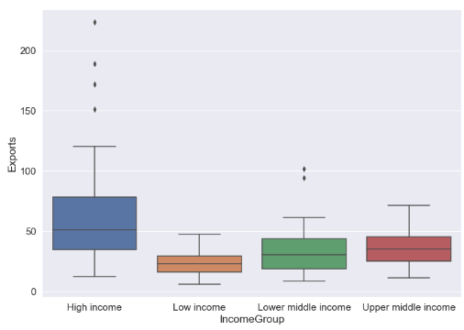
High income countries spend more on research and development and have more exports
The more a country exports, the more the economy grows, the greater the development is seen

Slide 6
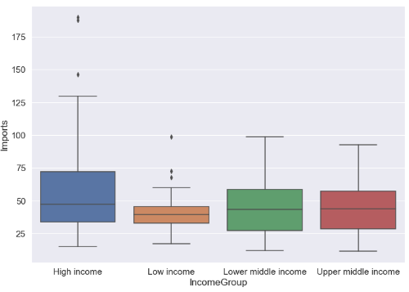
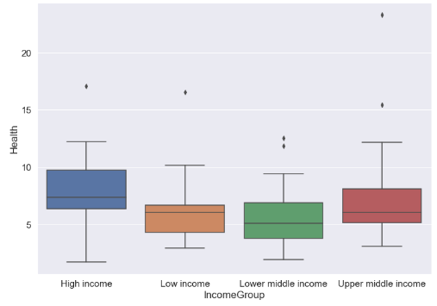
Similar expenditure on imports and health
This is concerning as it means the poorer countries have a greater trade deficit than richer countries and this has implications that the gap between the developed and the developing nations will continue to get wider

Slide 7
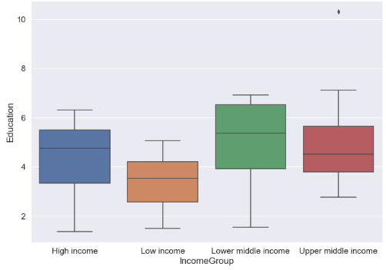
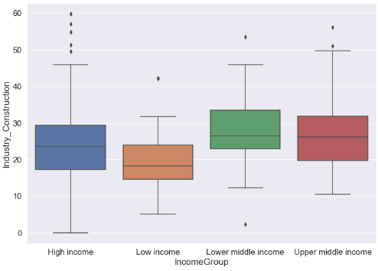
Middle income countries spend more on education and construction than low income
. Education is the key to development and progress. This is valuable insight into why other countries are becoming richer, whilst others are still stuck in poverty.

Slide 8
Conclusion
The project was very insightful and informative
Low income spend more on agriculture
High income nations spend more on research and development
. It is vital to solve this cycle if we are to uplift the billions of lives who are still stuck in extreme poverty

